Slide 1

FAST NATIONAL UNIVERSITY OF COMPUTER AND EMERGING SCIENCES
DEPARTMENT OF COMPUTER SCIENCE(CS)
BATCH 2020

Slide 2
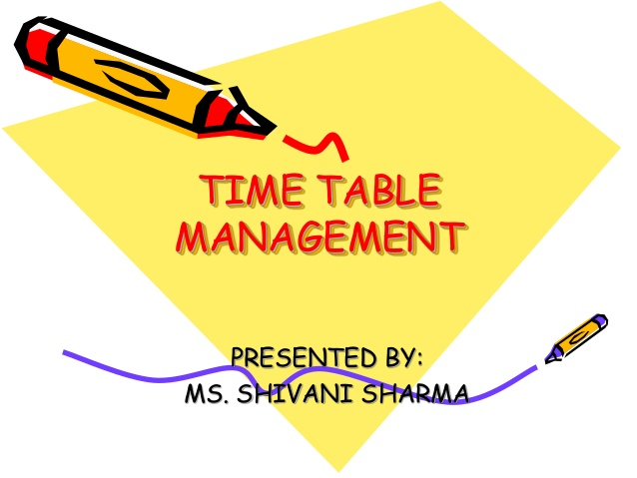
PROJECT TITLE:
TIME TABLE MANAGEMENT SYSTEM
SYEDA RAVIA EJAZ

Slide 3
GROUP MEMBERS:
AYESHA ZIA (20K-0414)
SYEDA RAVIA EJAZ
(20K-0246)

Slide 4
INTRODUCTION:
Time table can be defined as a schedule of events that organizes college activities throughout the day, week, semester or year. A college time table is an arrangement of a set of lectures and classrooms in which all given constraints are satisfied. Time table management system contains a database, which stores the staff and students personal details.
Creating such timetables manually is complex and time-consuming process. By automating this process with computer assisted time table generator will save a lot of precious time of administrators who are involved in creating and managing course time table.
Hence our project introduces a practical time tabling algorithm capable of taking care of every necessary requirements so that each teacher and student can view their time table for the present semester but they can’t edit them.

Slide 5
Objective:
The main objective was to develop a user friendly time table generator in completely automated way which will save a lot of time and effort of the university administration. The program aims to automate the process of taking records and getting the desired information.

Slide 6
BACKGROUND:
A key factor in running an educational center is the need for a well-planed, well-throughout and clash-free time tables. Creating such time tables manually requires hard work and plenty of useful time.
In order to save the previous time and hard work of the administrators, we have designed a computer assisted time table generator through which every student can view their timetable and get the information about their respective classes scheduled for the week moreover every teacher can view their time table for the given semester.

Slide 7
USER INTERFACES:
our program is designed mainly for two users:
Students:
the one who intends to view the time table of their respective classes scheduled for the week.
Teachers:
the one who intends to view the timings of their free slots.
Multiple users can connect through the software for viewing the time table management system.

Slide 8
CHARACTERISTICs:
STUDENTS:
Students can view their class schedule(time, date and venue) for the entire week.
They can view their upcoming assignments or quizzes(due) for the week.
They can view the details of their respective courses taught in the semester.
One additional factor is the directions of the class which direct the students to their respective classes.
TEACHERS:
Teachers can view their free slots of the day.
They can post assignments or quizzes for a particular section.
They can mark attendance of the students of a particular section and saves the record.

Slide 9
FUNCTIONS:
Following functions are used in designing the time table management system:
To integrate sound API the program uses the following function:
PlaySound("C:/WINDOWS/Media/ding.wav", NULL, SND_FILENAME)
To clear the buffer output and move the buffered data to the console, the program uses the following functions:
fflush(stdin);
To move the cursor to the new screen, the program uses the following function:
system("CLS");

Slide 10
Structure of program:
Time table management system
student
Classes
Upcoming assignments/quizzes
teacher
Free slots
Course details
Post assignments/quizzes
Directions of class
Mark attendance

Slide 11
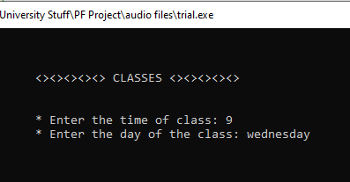
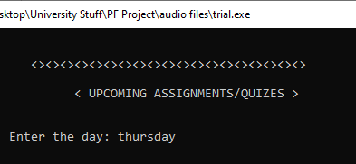
SYSTEM REQUIREMENTS SPECIFICATION:
FOR STUDENTS:
To view the schedule of the class, user have to input the time and day of the class.
To view the details of the assignments/quizzes, user have to input the day .

Slide 12
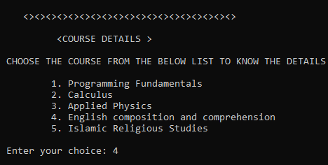
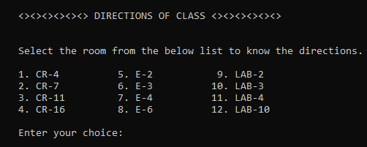
SYSTEM REQUIREMENTS SPECIFICATION:
FOR STUDENTS:
To view the details of the course, user have to select the course from the given list.
To know the directions of the class, user have to select the class from the given list.

Slide 13
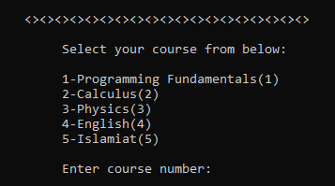
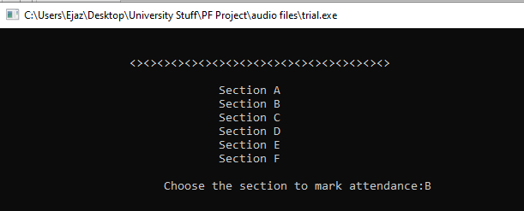
SYSTEM REQUIREMENTS SPECIFICATION:
FOR TEACHERS:
First of all user(teacher) have to select the course of their own.
To mark the attendance of the class, user have to select the section of the class.

Slide 14
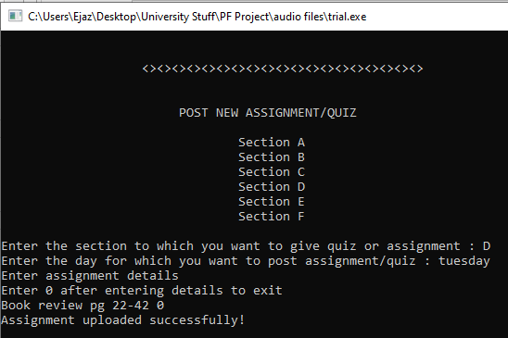
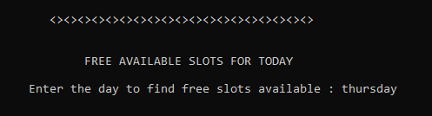
SYSTEM REQUIREMENTS SPECIFICATION:
FOR TEACHERS:
To post assignment, user have to input the name of the section, day, and the details of the assignments.
To view the free slots, user have to input the day .

Slide 15
tools and libraries USED:
TOOLS:
Switch(case) statements
Nested for loops
Functions(declaration, call, definition)
Structures
Filing and pointers
One and Two dimensional arrays
Strings
If/else nested conditions
Play sound (for voice notes)
LIBRARIES:
<stdio.h>Standard input/output library to get input from user and output the result on the monitor (screen).
<string.h> defines various functions for manipulating arrays of characters.
<windows.h>defines a very large number of windows specific functions that can be used in C.
<mmsystem.h>header file for windows multimedia functions.

Slide 16
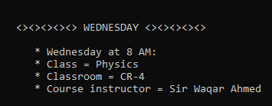
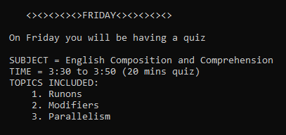
FINAL OUTPUT: student screen
Classes:
Our program will display the name of the course, course instructor and classroom for the respective entered day and time.
Assignments/quizzes:
Our program will display the name of the subject of the assignment/quizzes and the details of the assignment/quizzes on the entered day.

Slide 17
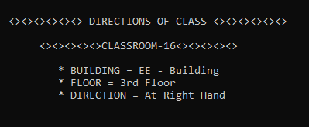
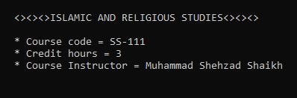
FINAL OUTPUT: student screen
Directions of class:
Our program will display the name of the building, floor and directions to where class is located.
Course details:
Our program will display the course code, credit hours and name of the course instructor.

Slide 18
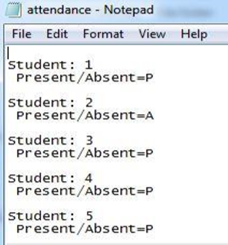
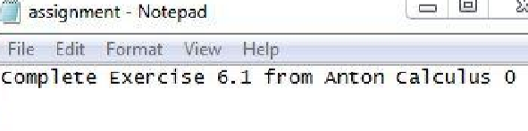
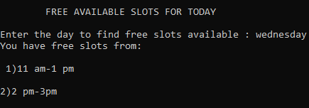
FINAL OUTPUT: TEACHER SCREEN
Attendance:
The attendance mark by the teacher will be saved in a text file.
Assignments:
The assignment posted by the teacher will be saved in a text file.
Free slots:
The program will display the timings of the free slots.

Slide 19
CONCLUSION:
Our approach of developing timetabling system was proved successful and practical as well as it demonstrated its suitability for solving university lecture-course timetabling problem. The designed system is a user friendly system and is easy to use. Multiple users can interact with the system to know the information.

Slide 20
THANK YOU !!!
PROJECT DESIGNED BY:
AYESHA ZIA
SYEDA RAVIA EJAZ

